Slide 1

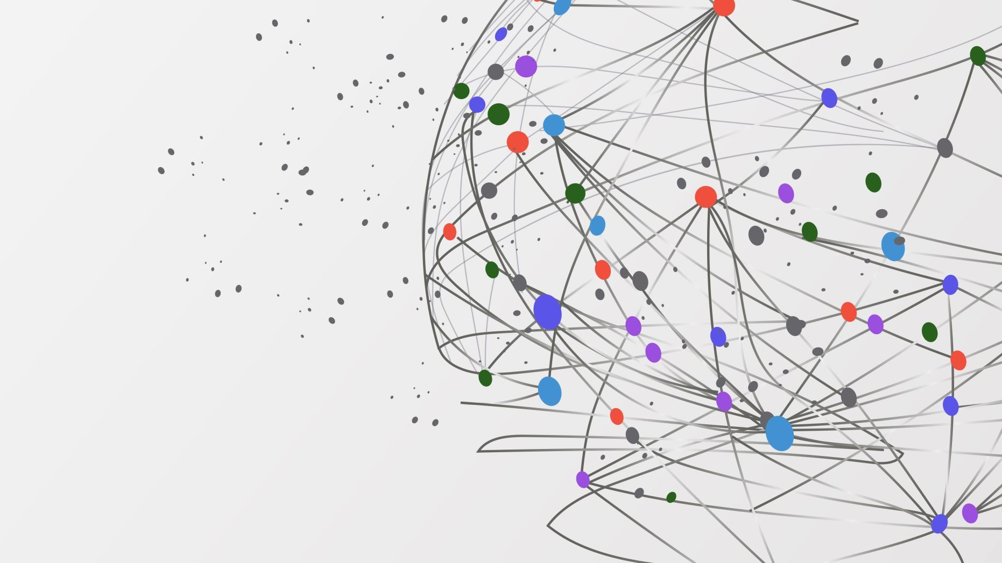
TAO: Facebook's Distributed Data Store for the Social Graph
Nathan Bronson, Zach Amsden, George Cabrera, Prasad Chakka, Peter Dimov Hui Ding, Jack Ferris, Anthony Giardullo, Sachin Kulkarni, Harry Li, Mark Marchukov Dmitri Petrov, Lovro Puzar, Yee Jiun Song, Venkat Venkataramani Facebook, Inc.
By
Likhitha Javvaji
Naveen Reddy Narayana

Slide 2
The Social Graph
A flexible representation that directly models real-life objects and relationships.
Objects(Typed Nodes) connected by Associations(Typed Edges) from the graph.
Objects model People, Places, Posts etc and repeatable Actions.
Associations model relationships, non-repeatable Actions and State Transitions.
Associations are directed, and often are tightly coupled with an inverse edge.

Slide 3
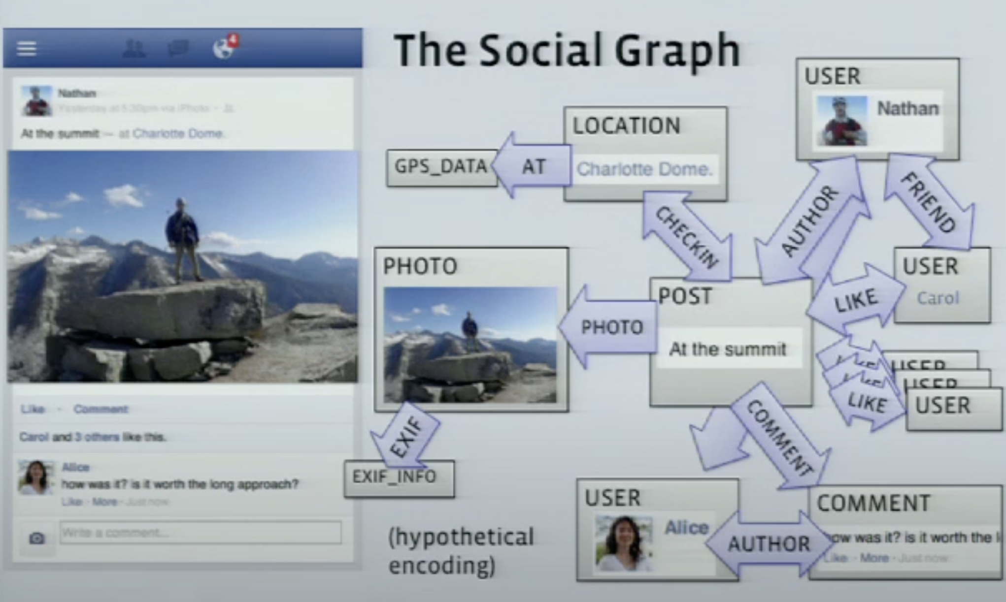
The Social Graph

Slide 4
Characteristics of a Social Graph
Both Objects and Associations encode data as Key Value pairs.
The graph is read-heavy; Each page view involves fetching hundreds of items.
Recent items are often read the most
Read after Write consistency is critical; Eventual Consistency is acceptable.

Slide 5
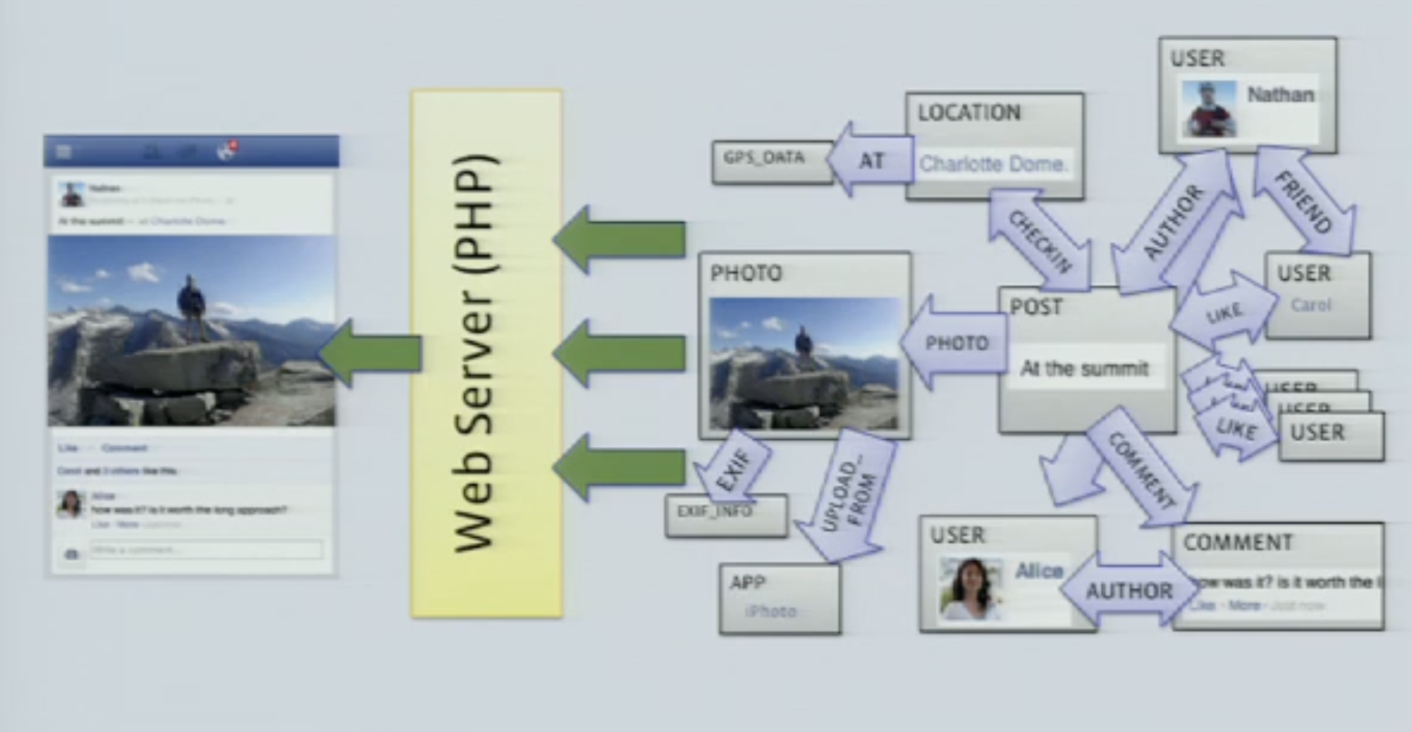
Before TAO
The Social Graph is stored in MySQL, with masters and slaves distributed across "Regions".
Memcached pools per "Region" function as a lookaside cache for Objects and Associations.
A PHP abstraction provides an Object-Association API without directly MySQL access for applications.
Data mapping, Cache invalidations and Control logic are implemented in the PHP client.
Problems:
● Operations on lists are inefficient in Memcached (update whole list).
● Complexity of clients managing cache.
● Hard to offer read-after-write consistency.

Slide 6
Before TAO Architecture: Challenges and why the existing methods not work
Lookaside caches require a distributed control logic to avoid "Thundering Herds".
Edge Lists cached in a Key-Value store have to be invalidated completely on updates.
Harder Read After Write consistency.
Accessing the Graph data from non-PHP services.

Slide 7
TAO and Its Objectives
TAO is a geographically distributed data store that provides efficient and timely access to the social graph for Facebook's demanding workload using a fixed set of queries. It is deployed at Facebook, replacing memcache for many data types that fit its model.
The main objectives of TAO were
Efficiency at scale
Timeliness of writes
High Read availability

Slide 8
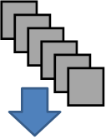
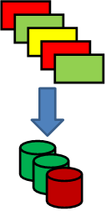
Basic Structure
Webservers
Stateless
Cache servers
Objects, Association Lists
Partitioned based on <id>
Database
Partitioned based on <id>

Slide 9
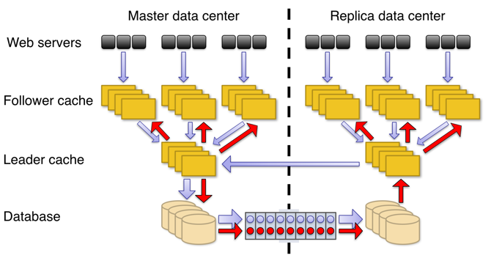
TAO Architecture

Slide 10
TAO Architecture
TAO is separated into two caching layers and a storage layer.
Storage Layer
Objects and associations were stored in MySQL at Facebook even before TAO was built; it was the backing store for the original PHP implementation of the API. This made it the natural choice for TAO’s persistent storage
Each object id contains an embedded shard id that identifies its hosting shard. Objects are bound to a shard for their entire lifetime. An association is stored on the shard of its id1, so that every association query can be served from a single server. Two ids are unlikely to map to the same server unless they were explicitly colocated at creation time.

Slide 11
TAO Architecture
Cache Layer
Like in the Memcache , it is still very important to load database workload using a caching layer. A client requesting information connects to a cache first. This cache belongs to a tier consisting of multiple such caches and the database. They are collectively responsible for serving objects and associations.
If there is a read-miss then caches can contact the nearby caches or go to the database. On a write, caches go the database for a synchronous update. This helps with read-after-write consistency in most cases

Slide 12
TAO: Consistency Model
TAO is eventually consistent owing to the asynchronous replication behaviour across regions and across followers.
Read-After-Write consistency is assured in the same tier owing to the synchronous delivery of the changeset applied. Changesets are only applied after verifying that current "version" of the data in the cache matches the pre update value in the changeset.
Inconsistencies may arise in case of partial leader failure of follower failures during writes which resolve themselves on receiving the invalidation/refill messages.

Slide 13
TAO: Failure Handling
A storage layer master failure is handled by auto promoting an existing slave.
A storage layer slave failure is handled by redirecting follower reads to the leader in the shard's master region. Invalidation/refill messages are delivered from the master region.
On slave promotion, the embedded invalidation/refill messages may be replayed in all regions to ensure data consistency.
On a leader cache server failure, followers handle cache misses by reading directly off the storage layer.
Refill and invalidation failures are handled by queuing the messages to the disk to be delivered later.
Follower server failures are handled by the client by routing requests to a backup follower tier.

Slide 14
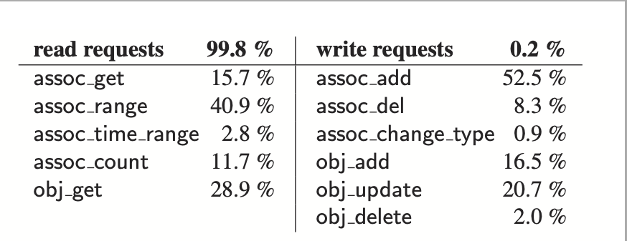
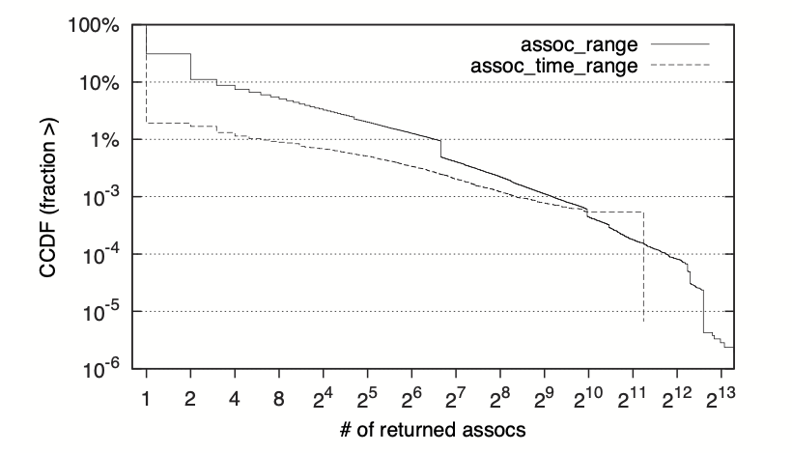
TAO: Workload and Performance
Only 0.2% of the requests are writes.
Association lists are very often empty or small.

Slide 15
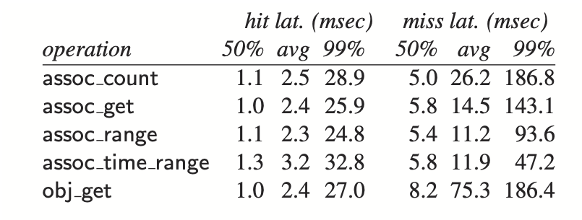
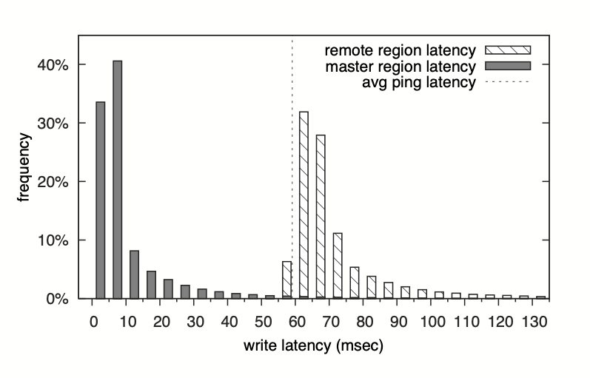
TAO: Workload and Performance
Overall hit rate of 96.4%
Read Latencies
Write Latency

Slide 16
Conclusion: Major Contributions
Overall, this paper makes three contributions.
First, it characterize a challenging Facebook workload: queries that require high throughput, low latency read access to the large data, changing social graph.
Second, it describe the objects and associations data model for Facebook’s social graph, and the API that serves it.
Lastly, it detail TAO, as geographically distributed system that implements this API.

Slide 17
Impact Of This Work
TAO is deployed as efficient scale inside Facebook.
Its separation of cache and persistent store has allowed those layers to be independently designed, scaled, operated, and maximizes the reuse of components across organization.
This separation also allows to choose different tradeoffs for efficiency and consistency at the two layers, and to use an idempotent cache invalidation strategy.
TAO’s restricted data and consistency model has proven to be usable for application developers while allowing an efficient and highly available implementation.

Slide 18
References:
J.Baker,C.Bond,J.C.Corbett,J.Furman,A.Khorlin,J.Larson, J.-M. Leon, Y. Li, A. Lloyd, and V. Yushprakh. Megastore: Pro- viding scalable, highly available storage for interactive services. In Proceedings of the Conference on Innovative Data system Re- search, CIDR, 2011.
F. Chang, J. Dean, S. Ghemawat, W. C. Hsieh, D. A. Wallach, M. Burrows, T. Chandra, A. Fikes, and R. Gruber. Bigtable: A distributed storage system for structured data. In Proceedings of the 7th USENIX Symposium on Operating System Design and Implementation, OSDI. USENIX Assoc., 2006.
B. F. Cooper, R. Ramakrishnan, U. Srivastava, A. Silberstein, P. Bohannon, H.-A. Jacobsen, N. Puz, D. Weaver, and R. Yer- neni. PNUTS: Yahoo!’s hosted data serving platform. PVLDB, 1(2), 2008.
J. C. Corbett, J. Dean, M. Epstein, A. Fikes, C. Frost, J. J. Furman, S. Ghemawat, A. Gubarev, C. Heiser, P. Hochschild, W. Hsieh, S. Kanthak, E. Kogan, H. Li, A. Lloyd, S. Melnik, D. Mwaura, D. Nagle, S. Quinlan, R. Rao, L. Rolig, Y. Saito, M. Szymaniak, C. Taylor, R. Wang, and D. Woodford. Spanner: Google’s globally-distributed database. In Proceedings of the 10th USENIX Conference on Operating Systems Design and Implementation, OSDI, Berkeley, CA, USA, 2012.

Slide 19


